Slide 1
Lecture 12.
Advanced Data Structures (2)
Instructor: 黄群
huangqun@pku.edu.cn
School of EECS
Peking University

Slide 2
Outline
Red-Black Tree (RB Tree)
Splay Tree

Slide 3
Review of AVL Tree
AVL Trees
To keep balance: 3 major cases for both insertion and deletion
4 violation sub-cases for insertion
3 violation sub-cases for deletion
Worst-Case Complexity: O(log n)
For insert, delete, lookup

Slide 4
RB Tree: Definition
Balanced Extended Binary Tree
Color of node: red or black
Root always black
External nodes: always black
Internal nodes: red or black
Requirement
The two children of a red node must be black
No two red nodes are adjacent
(Simple) paths from a node to its descendant external node have the same number of black nodes

Slide 5
Rank
Each node X has a rank:
Number of black nodes from X to any descendant external node
X is not included
The external node is included
Also called “height of black”
Rank of external nodes is zero
Rank of RB Tree: rank of root

Slide 6
Properties
(1) If external nodes are considered, an RB Tree is a full binary tree
(2) An RB Tree of rank k, from root to any external node
The path length is at least k, at most 2k

Slide 7
Properties (Cont.)
(3) An RB Tree with rank k has its height at least k+1, and at most 2k+1
(4) An RB Tree with rank k has at least 2^{k}-1 internal nodes
(5) An RB Tree with n internal nodes as its height at most 2 log₂ (n+1)+1

Slide 8
Operations
Look up a node
Same as binary tree
Insert & delete
Need to maintain RB tree requirement
No red nodes are adjacent
Paths from a node to its descendant external nodes have the same number of black nodes

Slide 9
Insert: Procedure
Step 1: Do a standard BST insert
Recall that the inserted position must be an external node before insertion
Step 2: Color the new node as red
Do not increase rank of any internal nodes
Step 3: Examine properties of RB Tree
Case 1: Parent is black?
Done
Case 2: Parent is red (Double red)?
Case 2.1 Black uncle: rotation
Case 2.2 Red uncle: switch color
6
Insert 4
Parent
6
Uncle
3
8
3
8
X
X
4

Slide 10
Insert Case 2.1: Black Uncle - Rotation
5 nodes
Insert Node: X
Sibling: α
Parent: A
Grandparent: B
Uncle: C
Use grandparent as rotation centric
Rank=k
Rank=k
B
A
A
Rank=k-1
C
X
B
Rank=k
X
α
α
C
Rank=k
Rank=k-1
Rank=k-1
Rank=k-1

Slide 11
Insert Case 2.1: Black Uncle - Rotation
4 possible forms
Key principle
Insert Node X, Parent A, Grandparent B
Median of X, A, B is the new root
Keep in-order of the remaining
2
6
6
2
6
2
4
4
4
4
2
6
4
2
6

Slide 12
Insert Case 2.2: Red Uncle – Switch Color
Switch color between grandparent and parent
Grandparent becomes red
Parent and uncle become black
Not change the rank of B’s ancestors
Grandparent may lead to Double Red problem with its parent
Continue check till the root
Perform Rotation or Switch Color
B
B
Continue Check
A
Change Color
C
A
C
X
α
X
α

Slide 13
Insert: Example
Insert 4
Case 2.2: Switch Color
11
11
2
14
2
14
7
1
7
15
1
7
15
5
8
5
8
5
8
X
X
4
4

Slide 14
Insert: Example
Insert 4
Case 2.1: Rotation
11
7
2
14
2
11
X
7
1
7
15
5
8
14
1
5
5
8
5
4
15
4

Slide 15
Delete Procedure
Call BST’s Delete, do you remember?
If the node to delete has two external nodes or one external node, delete directly
If the node to delete has no external nodes, swap it with the smallest node in right subtree, then delete
Assume X is the actual deleted node
In all cases, we need to check properties of RB Tree
Case 1: X is red
Done
Case 2: X is black, has a red child
Replace X with the red child, change the color to black
Case 3: X is black, no red child
Case 3.1: X has red Sibling
Case 3.2: X has black Sibling and no red Newphew
Case 3.3: X has black Sibling and at least one red Nephew
Two sub-cases
X
Y
Y
X
Now remove this node

Slide 16
Delete Case 3.1: Red Sibling
Nodes:
Deleted node: X
X’s red sibling: C
Parent node: B
Solution: rotation
C becomes parent node
Mark C as black
Mark B as red
Reduce to Case 3.2 or Case 3.3
B
C
Rank k
Rank k
X
C
B
β
Rank k
X
Rank k
α
β
α
Rank k
Rank k

Slide 17
Delete Case 3.2: Black Sibling and No Red Nephew
Rank k+1
Nodes:
Deleted node: X
X’s black sibling: C
Parent node: B
Solution: switch color
Mark C as red
Mark B as black
If B is red before switching
The rank of B’s ancestors remain, can stop
Otherwise
Need further check
B
B
Rank k
Need to further check
X
C
X
C
Rank k
Rank k (can delete)
D
E
D
E
Rank k-1
Rank k-1
Rank k-1
Rank k-1

Slide 18
Delete Case 3.3: Black Sibling and with Red Nephew
Two sub-cases
B
B
X
C
X
C
α
D
D
E
Sub-Case 3.3.1:
X is B’s left (right) child,
But D is C’s right (left) child
Sub-Case 3.3.2:
X is B’s left (right) child,
and D is also C’s left (right) child

Slide 19
Delete Sub-Case 3.3.1: Rotation
Sibling C becomes the new parent
C inherits the color of B
Mark B as Black
Mark D as Black
Rank k+1
B
C
Rank k
Rank k (after delete)
Rank k
X
C
B
D
Rank k
Rank k
α
D
X
α
Rank k (can delete)

Slide 20
Delete Sub-Case 3.3.2: Rotation
D becomes the new parent
D inherits the color of B
Mark B as black
Rank k+1
B
Rank k+1
Rank k
X
Rank k
C
D
Rank k (after delete)
Rank k
Rank k
Rank k-1
D
E
B
C
Rank k-1
X
E
Rank k (can delete)
α
β
α
β

Slide 21
Delete: Example
Delete 90
Case 3: X is black, and X has no red child
Case 3.2: C is black and C has no red child
After switching color between 70 and 80, no further check
65
65
B
B
50
80
50
80
80
C
X
C
X
70
10
60
70
90
10
60
70
62
62

Slide 22
Delete: Example
Delete 70
Case 1: Delete a red node, no check
65
50
80
10
60
70
62

Slide 23
Delete: Example
Delete 80
Case 3.1: X is black, X has no red child, X has red sibling
Rotation, reduce to Case 3.3: X has black sibling and red newphew
B
50
C
65
X
B
50
80
10
65
C
10
60
60
X
62
E
D
62

Slide 24
Delete: Example
Delete 80（Cont.）
Sub-Case 3.3.2: X is right child, its red newphew D is also right child
50
50
B
D
10
65
C
10
62
X
60
C
B
E
D
60
65
62
X

Slide 25
Analysis of RB Tree
Lookup
Average case: O(log₂ n)
Worst case: O(log₂ n)
Insert and Delete
Average case: O(log₂ n)
Worst case: O(log₂ n)
Recall the tree height is at most 2 log₂ (n+1)+1

Slide 26
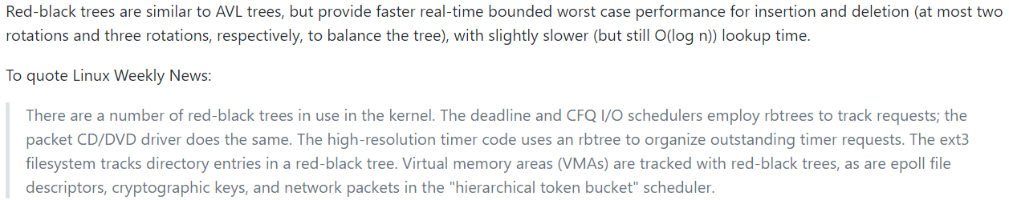
RB Tree in Practice
Used in Linux Kernel and STL
Less rotations (in practice) compared to AVL Tree
More stable performance compared to Splay Tree
https://github.com/torvalds/linux/blob/master/Documentation/core-api/rbtree.rst

Slide 27
Outline
Red-Black Tree (RB Tree)
Splay Tree

Slide 28
Splay Tree
A self-adjusting BST
the tree structure can be changed during the search operation
A set of rules to improve the performance of BST
Reduce the cost of search and modification
No guarantee of the balance

Slide 29


Splay Tree
Fast both in worst-case amortized analysis and in practice
Used in the kernel of Windows NT for keep track of process information
Also used in Input Method
Invented by Daniel Sleator and Robert Tarjan in 1985
Robert Tarjan (Turing Award 1986)
Daniel Sleator

Slide 30
Splay Tree: Basic Idea
“Blind” rebalancing – no height info kept
Good locality
“Locality” – if an item is accessed, it is likely to be accessed again soon
Most commonly accessed keys move high in tree
Become easier and easier to find
Worst-case time per operation is O(n)
Worst-case amortized time is O(log n)
Insert/find/delete always rotates node to the root

Slide 31
Key Operation: Splaying
A splaying operation
When looking up or inserting x, move x to the root
When deleting x, move x’s parent to the root
A splaying operation is composed of a sequence of rotation operations
Rotation: involve x, x’s parent and x’s grandparent
Move x to higher position
We consider lookup operation first

Slide 32
Types of Rotation
Single Rotation (单旋转)
Only when X is root’s child
Double Rotation
Zig-Zig Rotation (一字型双旋转)
Zig-Zag or Zag-Zig Rotation (之字型双旋转)

Slide 33
Single Rotation
Used when X is direct child of root
Procedure:
Swap X with its parent
Then keep BST property
右旋 (zig)
y
x
A
y
x
C
A
B
B
C
左旋 (zag)

Slide 34
Double Rotation
Involve three nodes
X: node to be move to the root
Y: X’s parent
Z: Y’s parent (X’s grandparent)
Goal: move X up by 2 levels
Then keep the BST property
Types
Zig-Zig
Zig-Zag

Slide 35
Zig-Zag Rotation
Scenario:
X is Y’s right (left) child, but Y is also Z’s left (right) child
Same as Double Rotation in AVL Tree
z
Step 1: Single Rotation Between X and Y
y
D
A
x
B
C

Slide 36
Zig-Zag Rotation
Scenario:
X is Y’s right (left) child, but Y is also Z’s left (right) child
Same as Double Rotation in AVL Tree
z
Step 2: Single Rotation Between X and Z
x
x
D
y
z
y
C
A
B
C
D
A
B

Slide 37
Zig-Zig Rotation
Scenario:
X is Y’s left (right) child, and Y is also Z’s left (right) child
Step 1: Single Rotation Between Y and Z
z
y
D
x
C
A
B

Slide 38
Zig-Zig Rotation
Scenario:
X is Y’s left (right) child, and Y is also Z’s left (right) child
Step 2: Single Rotation Between X and Y
y
x
z
A
B
C
D

Slide 39
Putting It Together
To move X to the root, perform a sequence of double rotation
Each double rotation moves X by 2 levels
Until X reaches root, or root’s child
If x reaches root’s child, perform an additional single rotation

Slide 40
Example
h
g
I
(a-b-c)
Zig-Zig Rotation
f
H
A
e
d
G
c
(b, c) Zag
B
C
b
(a, b) Zag
D
a
E
F

Slide 41
Example
h
g
I
f
H
a-d-e
Zig-Zag Rotation
(a, e) Zig
A
e
d
G
B
a
(a, d) Zag
b
F
c
E
C
D

Slide 42
Example
h
(a, g) Zig
(a-f-g)
Zig-Zag Rotation
g
I
f
H
A
a
(a, f) Zag
d
e
B
b
F
G
c
E
C
D

Slide 43
Example
(a, h) Zig
h
Single Rotation
a
I
f
g
A
d
e
H
B
b
F
G
c
E
C
D

Slide 44
Example
a
f
h
A
d
g
I
B
b
e
H
c
E
F
G
C
D

Slide 45
The Order in Zig-Zig is Important
Why do we swap Y and Z first, but not X and Y first in Zig-Zig Rotation?
Further, if we swap X and Y first, we do not need to distinuigh Zig-Zag Rotation and Zig-Zig Rotation
We just use one rule: repeated Single Rotation with its parent
Answer: only using Single Rotation is correct, but not efficient

Slide 46
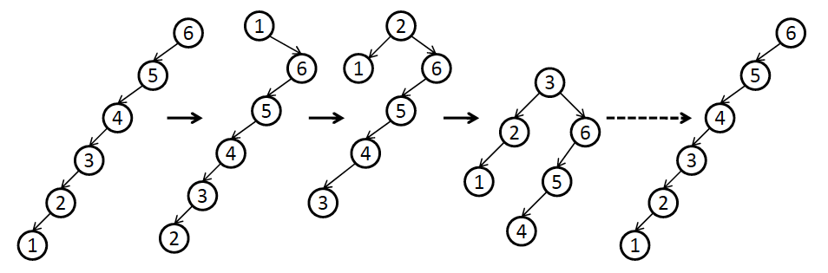
If We Use Only Single Rotation
Adjust 1 to root
Adjust 2 to root

Slide 47
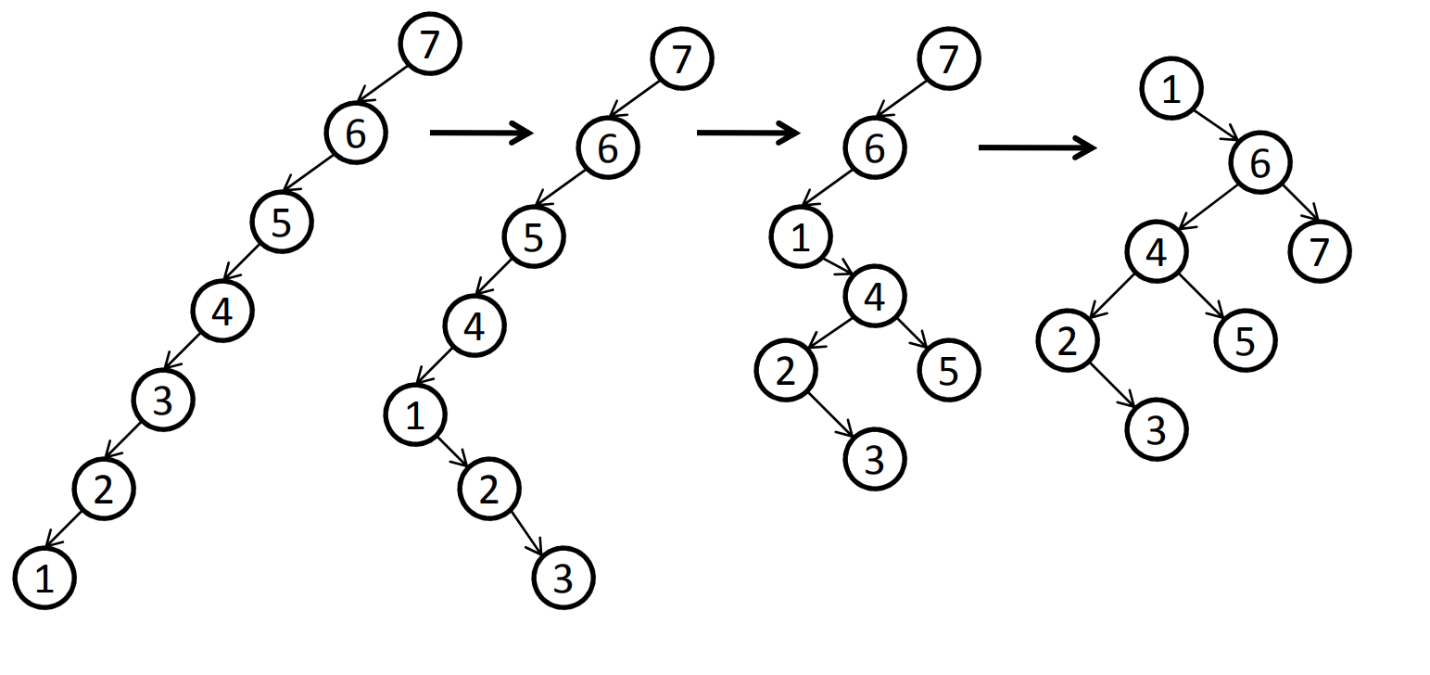
But If We Use Double Rotation

Slide 48
Why Splaying Helps: Zig-Zag
Helped
Unchanged
Hurt
g
n
up 2
X
p
g
p
down 1
down 1
up 1
n
W
X
Y
Z
W
Y
Z
Notes:
This is just a double rotation.

Slide 49
Zig-Zig
Helped
Unchanged
Hurt
g
n
W
p
p
Z
X
n
g
Y
Y
Z
W
X

Slide 50
Why Splaying Helps
Node X and its children are always helped (raised)
Nodes that are hurt by a zig-zag or zig-zig are later helped by a rotation higher up the tree
Result:
Shallow nodes may increase depth by one or two
Helped nodes decrease depth by a large amount
If a node X on the access path is at depth d before the splay, it’s at about depth d/2 after the splay
Exceptions are the root, the child of the root, and the node splayed

Slide 51
Performance
Assume m ≥ n access in a tree of size n
Total worst case time is O(m log n)
O(log n) per access amortized time
Suppose only k distinct items are accessed in the m accesses
Time is O(k log n + m log k )
Compare with O( m log n ) for AVL tree
those k items are all at the top of the tree
getting those k items near root

Slide 52
Splay Tree: ADT
struct TreeNode {
int key;
ELEM value;
TreeNode *father, * left, *right;
};
Splay(TreeNode *x, TreeNode *f); // Rotate x to be a child of f
Find(int k) ;
Insert(int k)；
Delete(TreeNode *x) ;
DeleteTree(TreeNode *x);

Slide 53
Splay Operation
void Splay (TreeNode *x, TreeNode *f) {
while (x->parent != f) {
TreeNode *y = x-> parent, *z = y-> parent;
if (y->parent != f) { // f is not y’s parent: double rotation
if (z->lchild == y) {
if (y->lchild == x)
{ Zig(y); Zig(x); } // Zig-Zig: note the order
else { Zag(x); Zig(x); }
} else {
if (y->lchild == x)
{ Zig(x); Zag(x); }
else { Zag(y); Zag(x); } // Zig-Zig: note the order
}
} else { // f is y’s parent: single rotation
if (y->lchild == x) Zig(x);
else Zag(x);
}
}
if (x->parent == NULL) Root = x;
}

Slide 54
Usage of Splay
Delete all nodes between node u and v
Step 1: Splay u to the node
Step 2: Splay v to be the right child of u
Step 3: Delete left subtree of v
void DeleteUV(TreeNode* rt, TreeNode* u, TreeNode* v )
{
Splay(u, NULL);
Splay(v, u);
DeleteTree(v->lchild);
v->lchild = NULL;
}

Slide 55
Insert: A More Efficient Method
To insert, could do an ordinary BST insert
but would not fix up tree
A BST insert followed by a find (splay)?
Better idea: do the splay before the insert
How?
Notes:
What about insert?
Ideas?
Can we just do BST insert?
NO. Because then we could do an expensive operation without fixing up the tree.

Slide 56
Need New Operation: Split
Split(T, x) creates two BST’s L and R:
All elements of T are in either L or R
All elements in L are ≤ x
All elements in R are > x
L and R share no elements
Then how do we do the insert?
Insert as root, with children L and R
Notes:
What about insert?
Ideas?
Can we just do BST insert?
NO. Because then we could do an expensive operation without fixing up the tree.

Slide 57
Splitting in Splay Trees
How can we split?
We have the splay operation
We can find x or the parent of where x would be if we were to insert it as an ordinary BST
We can splay x or the parent to the root
Then break one of the links from the root to a child
Notes:
How can we implement this?
We can splay.
We can find x or where x ought to be.
We can splay that spot to the root.
Now, what do we have?
The left subtree is all <= x
The right is all >= x

Slide 58
could be x, or what would have been the parent of x
split(x)
T
Look up x, and splay
L
R
if root is > x
if root is ≤ x
OR
L
R
L
R
≤ x
> x
< x
> x
Notes:
So, a split just splays x’s spot to the root then hacks off one subtree.
This code is _very_ pseudo. You should only use it as a general guideline.

Slide 59
Back to Insert
x
split(x)
L
R
L
R
≤ x
> x
Insert(x):
Split on x
Join subtrees using x as root
Notes:
Now, If we can split on x and produce one subtree smaller and one larger than x, insert is easy!
Just split on x.
Then, hang the left (smaller) subtree on the left of x.
Hang the right (larger) subtree on the right of x.
Pretty simple, huh?
Are we fixing up deep paths?

Slide 60
6
4
4
6
1
9
split(5)
1
6
1
9
4
7
2
9
2
7
2
7
Insert(5)
5
4
6
1
9
2
7
Notes:
Let’s do some examples.

Slide 61
Delete: A More Efficient Method
Similar to Insert, we can also Splay before Delete
x
find(x)
delete x
L
R
L
R
< x
> x
Now what?
Notes:
OK, we’ll do something similar for delete.
We know x is in the tree.
Find it and bring it to the root.
Remove it.
Now, we have to split subtrees.
How do we put them back together?

Slide 62
Need New Operation: Join
Join(L, R): given two trees such that L < R, merge them
Splay on the maximum element in L then attach R
splay
L
L
R
R
Notes:
The join operation puts two subtrees together as long as one has smaller keys to begin with.
First, splay the max element of L to the root.
Now, that’s gauranteed to have no right child, right?
Just snap R onto that NULL right side of the max.

Slide 63
Delete Completed
x
T
find(x)
delete x
L
R
L
R
< x
> x
Join(L,R)
T - x
Notes:
So, we just join the two subtrees for delete.

Slide 64
6
4
6
1
9
find(4)
1
6
1
9
4
7
2
9
2
7
Find max
2
7
Delete(4)
2
2
1
6
1
6
9
9
7
7

Slide 65
Summary
RB Tree
Property 1: no adjacent red nodes
Property 2: balanced number of black nodes
Insert & delete: rotate, switch color, reduce
Splay Tree
Property: implicit balance by leveraging ‘locality’
Find: zigzag and zigzag rotate to the root
Insert & delete: split, join

